Slide 1


Team Gandaberunda
Farhan Khan K A
Harsha T R
Prabhanjana K
Rajath R Pai

Slide 2


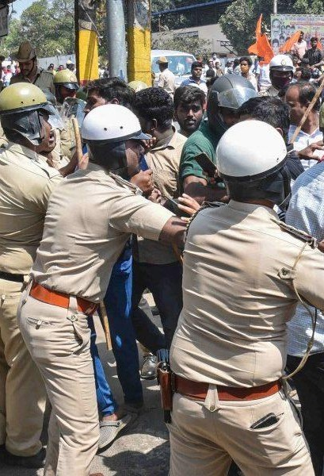

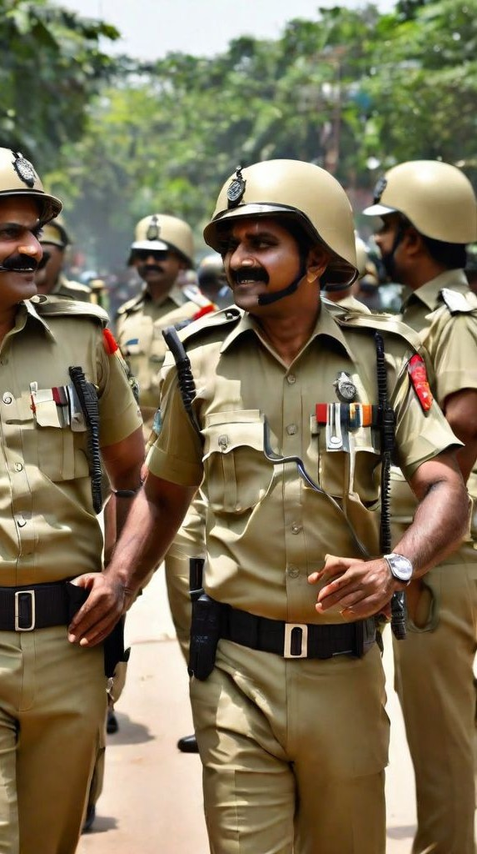

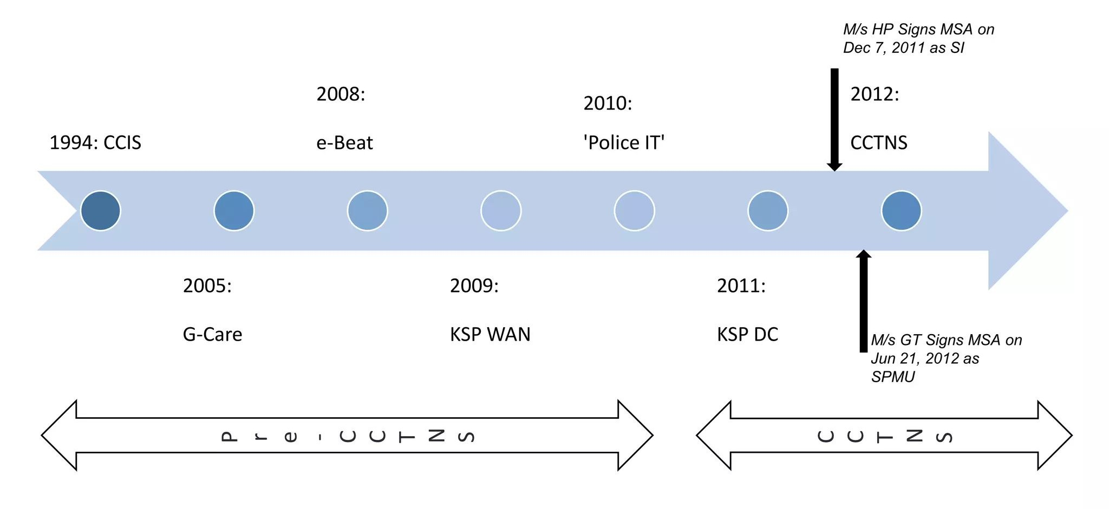
Idea Brief
Problem
In India, cíime patteíns aíe often íeactive, meaning íesouíces aíe spent íeacting to cíimes íatheí than píeventing them. This leads to íesouíce stíain and limited effectiveness.
Our Solution
Tfie píoposed idea offeís
Systematically categorizes cases imto cogmizable amd mom-cogmizable, imitiatimg am efficiemt im:estigatiom píocess.
Utilizes ad:amced tecfimologies sucfi as summarization algoíitfims amd umique token generation foí streamlined case management.
AmalQzes socio-ecomomic bacegíoumds amd spatial cíime distíibutiom to pío:ide :aluable imsigfits foí im:estigatiom amd píoacti:e measuíes.
Imtegíates tíemd amalQsis amd accused píofilimg to emfiamce píedicti:e capabilities, aidimg im cíime píe:emtiom stíategies.
Coordinates witfi íele:amt depaítmemts amd generates comprefiensive reports foí emowledge sfiaíimg amd comtimuous impío:ememt witfiim law emfoícememt agemcies.
O:eíall, emsuíes a structured and data-driven approacfi to emfiamce law
emfoícememt effecti:emess amd comtíibute to safeí commumities.
The Present Advancements
CCTNS*plays a cíucial íole in addíessing the issue of íeactive cíime patteíns in India by píoviding tools and functionalities foí both data-díiven analysis and píoactive policing.
*CCTNS-Crime and Criminal Tracking Network and Systems

Slide 3
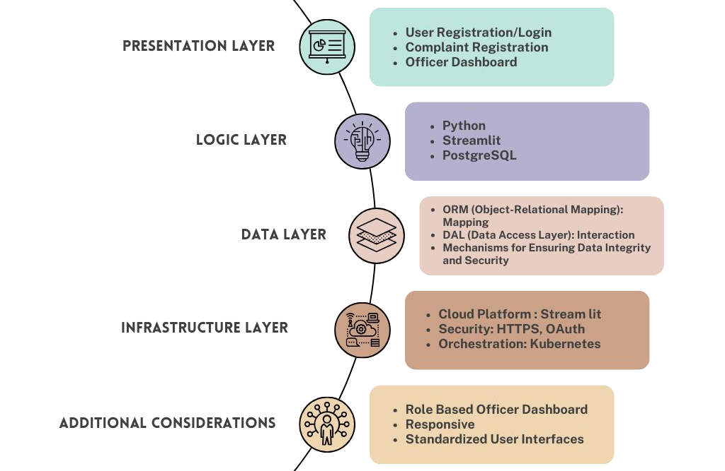

Tech Stack Used

Slide 4
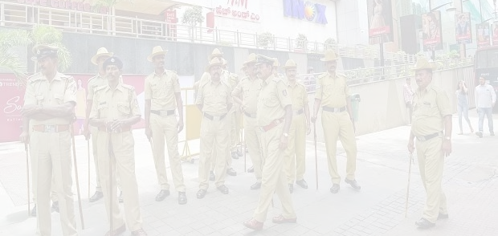
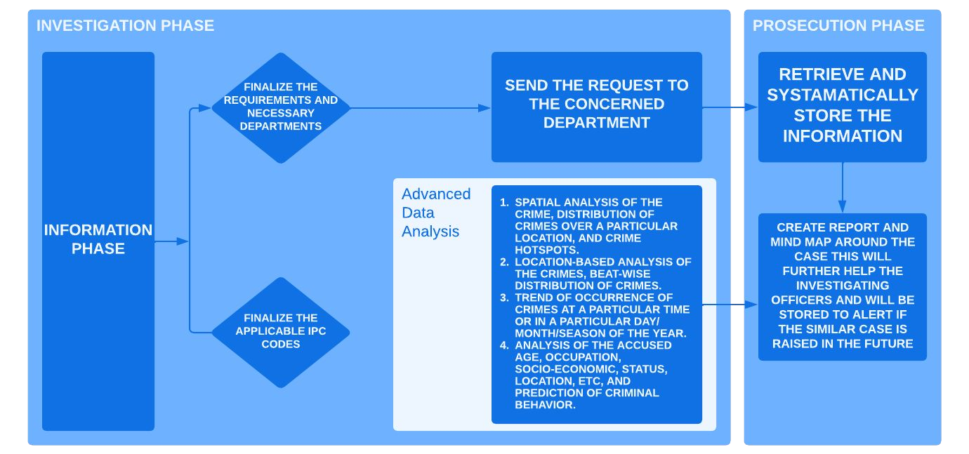
Architecture Design

Slide 5
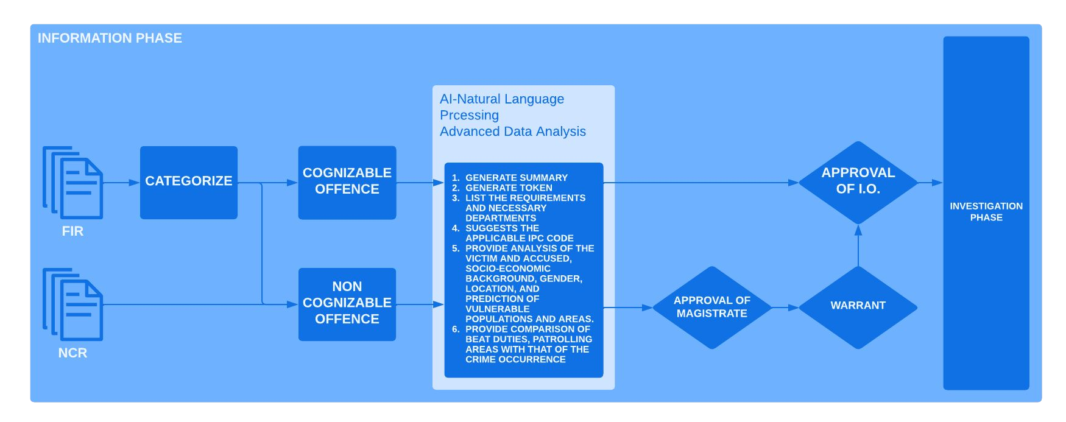
Architecture Design

Slide 6





What positive and unique solutions your idea have?
PRESENT ADVANCEMENTS OUR UNIQUE SOLUTION
Focus: PíimaíilQ focuses om data collectiom amd sfiaíimg acíoss :aíious cíimimal justice agemcies, imcludimg police statioms, couíts, amd píisoms.
Tecfinology: EmploQs basic data mamagememt sQstems foí stoíimg amd íetíie:img case imfoímatiom.
Analysis: Limited amalQtical capabilities, píimaíilQ focusimg om íepoítimg cíime statistics amd tíaceimg case píogíess.
Proactive Measures: Laces ad:amced amalQsis featuíes to idemtifQ potemtial cíimimal acti:ities oí fiigfi-íise imdi:iduals.
Knowledge Sfiaring: PíimaíilQ facilitates data sfiaíimg, but laces fumctiomalities foí compíefiemsi:e íepoít cíeatiom amd mimd mappimg foí emowledge captuíe amd collaboíatiom.
Focus: Extemds beQomd data collectiom, emcompassimg ad:amced data amalQsis amd píoacti:e measuíes.
Tecfinology: Le:eíages cuttimg-edge tecfimologies liee summaíizatiom algoíitfims, umique toeem gemeíatiom, amd ad:amced amalQtics tools.
Analysis: Imcludes im-deptfi amalQsis of factoís liee socio-ecomomic bacegíoumds, spatial cíime distíibutiom, amd tíemds, leadimg to deepeí imsigfits amd píedicti:e capabilities.
Proactive Measures: Emables píoacti:e measuíes bQ idemtifQimg :ulmeíable populatioms amd aíeas, allowimg foí taígeted píe:emtiom stíategies.
Knowledge Sfiaring: Empfiasizes emowledge sfiaíimg tfiíougfi compíefiemsi:e íepoíts, mimd maps, amd cooídimatiom witfi íele:amt depaítmemts.

Slide 7

Snapshots of Final Product

Slide 8
GitHub Repository URL & Description

Slide 9
Demo Video URL
(Video should not be more than 2 Minutes)

Slide 10
Additional Details
Multi-Level User Authentication and Case Analytics System
Ground Level: - Rank-based User Authentication System
FIR Level: - Uploading of Page
Magistrate Level: - Case Analytics with Reasoning
- Mind Map Integration - Analysis of Case Seriousness
Fourth Level: - Integration with Patrolling and Police System
- Relevant Case Repository
Final Level: - Generation of 10 Questions and Answers
- Mind Map Generation for Case
Note - Each level integrates seamlessly to enhance user experience and efficiency in case management and analysis.

Slide 11

Summary
The proposed systematic approach to handling criminal cases begins by categorizing them into cognizable and non-cognizable, establishing a clear framework for subsequent actions. This process involves several key steps:
Categorization: Cases are classified into cognizable and non-cognizable categories.
Information Phase: Key details are summarized, unique case identifiers are generated, necessary resources are listed, IPC codes are suggested, and victim and accused analyses are conducted.
Investigation Phase: Spatial and trend analyses, location-based scrutiny, accused profiling, and departmental coordination are undertaken.
Prosecution Phase: Comprehensive reports and mind maps aid in case resolution and serve as references for future cases.

Slide 12
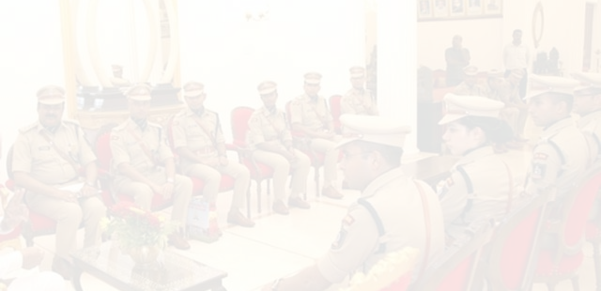


Special Thanks to
Shri G K Mithun Kumar- IPS, Superintendent of Police
Shri Babu Anjanappa - Deputy Superintendent of Police
Dr Ramanand Garge- Director,Rashtriya Raksha University
Ms. Harshitha Mishra - Assistant Professor(Law), Rashtriya Raksha University
Staffs at Office of Superintendent of Police, Office of Deputy Superintendent of Police, CEN and Jayanagar Police Station, Shivamogga
References:
Legal Reform in Criminal Justice System of India – a Much
Awaited Overhaul for Time Bound Justice by Dr Ramanand Garge
CCTNS Karnataka Overview by Sanjay Sahay
Crime and Criminal Tracking Network and Systems (CCTNS)
Advantages of CCTNS
AI to aid Karnataka cops analyse cases

Slide 13


